Slide 1

CAP 6317/4773: Social Media Mining
Lecture 15: Data Mining and Project Guidelines
Raiyan Abdul Baten, Ph.D.
February 29, 2024

Slide 2
Group Project

Slide 3
Group Formation
40 graduate students
8 teams of 5 members each
17 undergraduate students
3 teams (2 teams of 6 and 1 team of 5)
(We can also do 4 teams (3 teams of 4 and 1 team of 5) if needed)
Please let me know the groups by Friday midnight
I will assign group numbers randomly

Slide 4
Deliverables and Timeline
Week 11 | 3/19 | Project Proposal Presentation (Groups 1-6); slides due at midnight
 | 3/21 | Project Proposal Presentation (Groups 7-12); slides due at midnight
Week 15 | 4/16 | Final Presentations (Groups 1, 2, 3); slides due at midnight
 | 4/18 | Final Presentations (Groups 4, 5, 6); slides due at midnight
Test free week (4/20 - 4/26) | 4/23 | Final Presentations (Groups 7, 8, 9); slides due at midnight
 | 4/25 | Final Presentations (Groups 10, 11, 12); slides due at midnight
Exams week (4/27 - 5/2) | 4/29 | Final Project Report due (9 am on Mon, April 29, 2024)

Slide 5
Grading
40% of final grade
30% common + 10% individual
 | Common grade | Individual grade
Project Proposal Presentation | 10% | -
Final Presentation | 10% | 5%
Written Report | 10% | 5%

Slide 6
Guidelines
The project needs to have a set of Research Questions (RQs)
What are you probing? Why is it important?
RQs need to be relevant to this course
It can be part of your ongoing research project
But it needs to have a well-defined end goal
You are free to use any language/library/method you want
Use of AI is permitted: Build something ChatGPT cannot!
You can use existing datasets or collect new data
The research questions and data need to be from either
Social Media sources (network/non-network data)
Non-Social Media sources with social network component
Simulated/synthetic data

Slide 7












We are interested in ‘social’ + ‘media’ data
Information exchanged via contacts
Teams interact virtually
Editors interact to curate content
Collaborate on a project, ‘star’ others’ projects
Write papers together, cite others’ papers

Slide 8
Social Science
Network/computational Science
Social Media Mining
Statistics and Data Mining

Slide 9
Week 11 | 3/19 | Project Proposal Presentation (Groups 1-6); slides due at midnight
 | 3/21 | Project Proposal Presentation (Groups 7-12); slides due at midnight
Project Proposal Presentation
 | Common grade | Individual grade
Project Proposal Presentation | 10% | -
Each team gets 8 minutes to present their proposal
Must include the following items (2% common grade weight in each):
Motivation
Related Work
Research Question(s)
Data
Method

Slide 10
Project Proposal Presentation
Motivation
What are you probing? Why is this important?
Related Work
Describe at least one relevant work in literature. Explain how your work is different than theirs.
Research Question(s)
State the research hypothesis you would like to test in this project. The hypothesis should be specific enough to be tested quantitatively by your analysis.

Slide 11
Project Proposal Presentation
Data
How will you acquire and process the data?
Method
What analysis method will you apply to answer your research questions? (Statistical testing/machine learning/ deep learning/ network scientific tools)
What software libraries will you use?

Slide 12
Week 15 | 4/16 | Final Presentations (Groups 1, 2, 3); slides due at midnight
 | 4/18 | Final Presentations (Groups 4, 5, 6); slides due at midnight
Test free week (4/20 - 4/26) | 4/23 | Final Presentations (Groups 7, 8, 9); slides due at midnight
 | 4/25 | Final Presentations (Groups 10, 11, 12); slides due at midnight
Final Presentation
 | Common grade | Individual grade
Final Presentation | 10% | 5%
Each team gets 15 minutes to present, each member must participate
Must include the following items:
Motivation and RQs (1% common grade weight)
Literature review (1% common grade weight)
Data (2% common grade weight)
Method (3% common grade weight)
Results (2% common grade weight)
Discussion (1% common grade weight)
Contribution of each team member

Slide 13
Final Presentation
Motivation and Research Question(s)
What did you probe and why?
State the specific research hypotheses you tested

Slide 14
Final Presentation
Motivation and Research Question(s)
What did you probe and why?
State the specific research hypotheses you tested
Literature Review
Briefly summarize relevant works in literature. Explain how your work is different than theirs.

Slide 15
Final Presentation
Motivation and Research Question(s)
What did you probe and why?
State the specific research hypotheses you tested
Literature Review
Briefly summarize relevant works in literature. Explain how your work is different than theirs.
Data
Where did you acquire the data from?
How exactly did you pre-process the data?

Slide 16
Final Presentation
Method
What analysis method did you use?
What software library did you use?

Slide 17
Final Presentation
Method
What analysis method did you use?
What software library did you use?
Results
Did you find support for your hypotheses? Your claims should be backed by quantitative evidence
Include figure(s) or table(s) describing your results

Slide 18
Final Presentation
Method
What analysis method did you use?
What software library did you use?
Results
Did you find support for your hypotheses? Your claims should be backed by quantitative evidence
Include figure(s) or table(s) describing your results
Discussion
Do your results agree/disagree with prior results? Do your results extend prior knowledge? Were you expecting these results? What are the limitations? What can be done next?

Slide 19
Final Presentation
Method
What analysis method did you use?
What software library did you use?
Results
Did you find support for your hypotheses? Your claims should be backed by quantitative evidence.
Include figure(s) or table(s) describing your results
Discussion
Do your results agree/disagree with prior results? Do your results extend prior knowledge? Were you expecting these results? What are the limitations? What can be done next?
Contribution of each team member

Slide 20
Final Written Report
Exams week (4/27 - 5/2) | 4/29 | Final Project Report due (9 am on Mon, April 29, 2024)
 | Common grade | Individual grade
Written Report | 10% | 5%
3-4 pages + 1 page for reference and contributions of each member
IEEE conference format
Word, LaTeX, and Overleaf templates

Slide 21
Final Written Report
Abstract (0.5% common grade weight)
Motivation and RQs (1% common grade weight)
Literature review (0.5% common grade weight)
Data (2% common grade weight)
Method (3% common grade weight)
Results (2% common grade weight)
Discussion (0.5% common grade weight)
References (0.5% common grade weight)
Contribution of each team member
Provide sufficient details for someone to replicate your work. Include a link to a public Github repository with all your code.

Slide 22
Supervised Learning

Slide 23
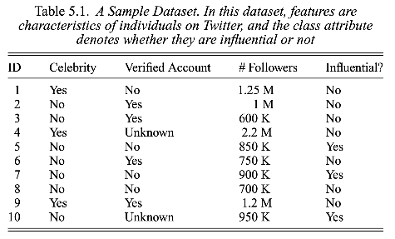
Trees and Forests

Slide 24
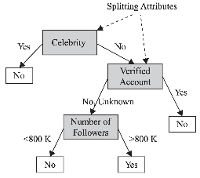
Trees and Forests

Slide 25

Trees and Forests
Non-leaf nodes denote tests on attributes

Slide 26
Trees and Forests
Branches denote outcome of the tests

Slide 27
Trees and Forests
Leaf nodes hold class labels

Slide 28
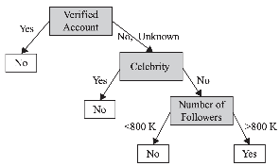
Trees and Forests

Slide 29
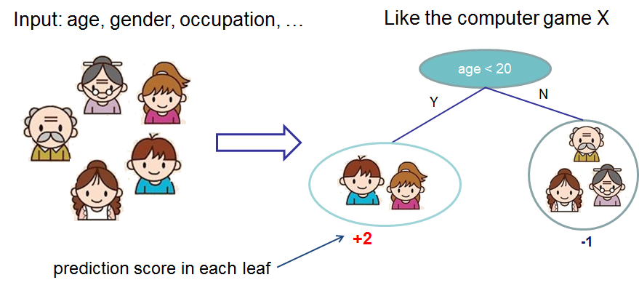

Slide 30
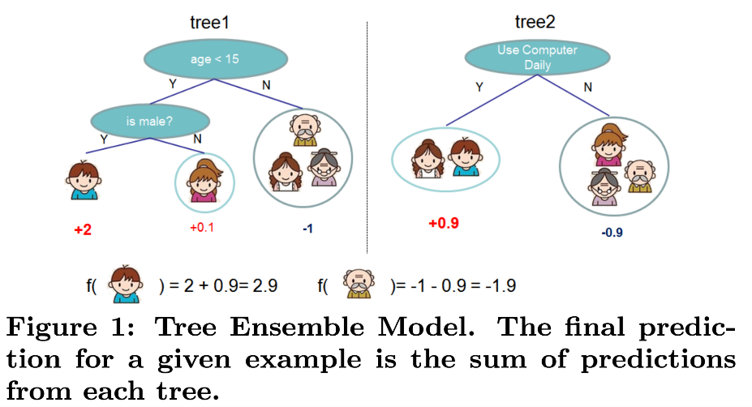

Slide 31
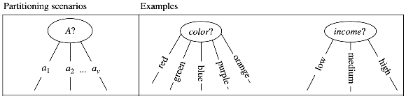
Decision Trees
The attribute is discrete-valued:
A branch is created for each value

Slide 32
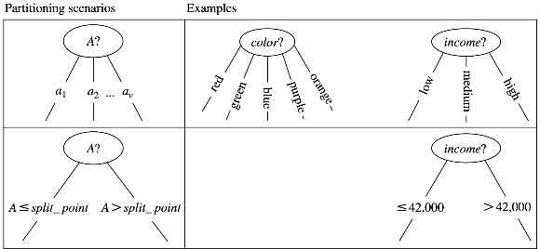
Decision Trees
The attribute is discrete-valued:
A branch is created for each value
The attribute is continuous-valued:
Split values along split points

Slide 33
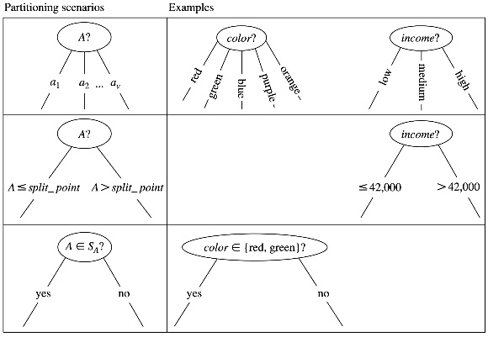
Decision Trees
The attribute is discrete-valued:
A branch is created for each value
The attribute is continuous-valued:
Split values along split points
The attribute is discrete-valued and a binary tree must be produced:
Split values along yes/no questions

Slide 34
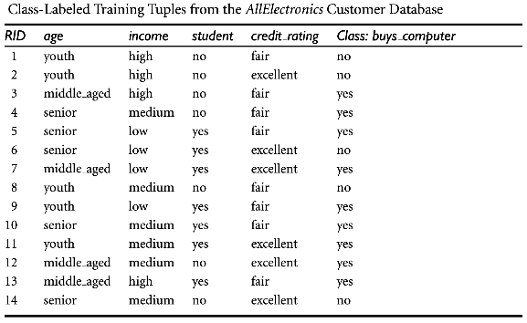
Decision Trees
Which attribute should we first use to split the data?
The goal is to pick an attribute that best partitions the tuples into distinct classes

Slide 35
Decision Trees

Slide 36
Decision Trees
In this dataset, all middle aged people buy a computer! No other attribute can split the data points so purely.

Slide 37
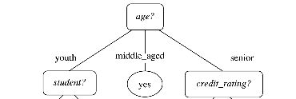
Decision Trees

Slide 38
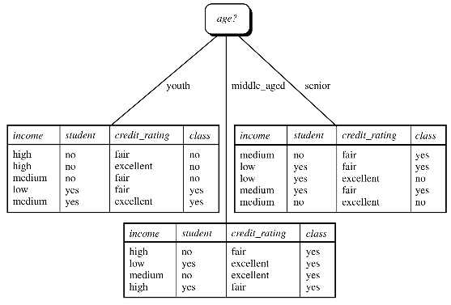
Decision Trees

Slide 39
Decision Trees

Slide 40
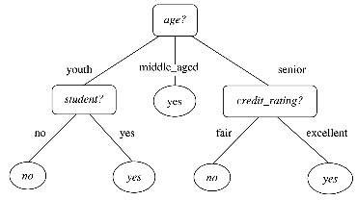
Decision Trees

Slide 41
Decision Trees

Slide 42
Decision Trees

Slide 43
Decision Trees
How can we quantify the purity of class labels along a splitted branch?

Slide 44
Decision Trees
How can we quantify the purity of class labels along a splitted branch?
Answer: Entropy!

Slide 45

If it is always head, there is no uncertainty!
Maximum uncertainty when p=0.5

Slide 46

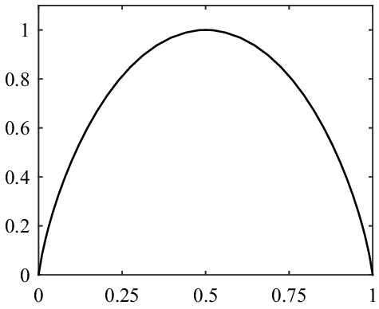
S
p(X=heads)

Slide 47
A Detour on Entropy
Entropy of 10 heads and 990 tails:

Slide 48
A Detour on Entropy
Entropy of 10 heads and 990 tails:
Entropy (uncertainty) close to 0, implying we’re highly certain that we’ll get a tail, implying the data split between head and tail is almost pure (only 10 heads out of 1000 tosses)

Slide 49
A Detour on Entropy
Entropy of 10 heads and 990 tails:
Entropy of 500 heads and 500 tails:

Slide 50
A Detour on Entropy
Entropy of 10 heads and 990 tails:
Entropy of 500 heads and 500 tails:

Slide 51
A Detour on Entropy
Entropy (uncertainty) is 1, which means the data split is random, no certainty whatsoever
Entropy of 10 heads and 990 tails:
Entropy of 500 heads and 500 tails:

Slide 52
Decision Trees
All ‘yes’. No uncertainty whatsoever! Entropy = 0, very pure

Slide 53
Decision Trees
Entropy = -(3/5)log₂(3/5) - (2/5)log₂(2/5)
= 0.97
Very high uncertainty, not so pure

Slide 54
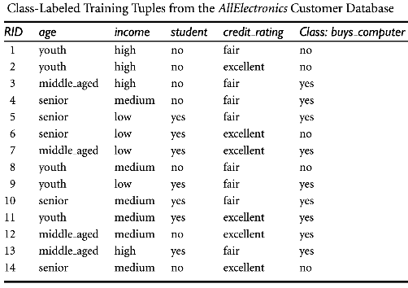
Decision Trees
Step 1:
Calculate the entropy of the class labels in the entire dataset, D. This is the expected amount of information needed to classify a tuple in D.

Slide 55

Decision Trees
Step 1:
Calculate the entropy of the class labels in the entire dataset, D. This is the expected amount of information needed to classify a tuple in D.

Slide 56
Decision Trees
Step 1:
Calculate the entropy of the class labels in the entire dataset, D. This is the expected amount of information needed to classify a tuple in D.
We have 9 ‘yes’ and 5 ‘no’ in our dataset

Slide 57

Decision Trees
Step 2:
We’re interested to see which feature has the ‘purest’ split of D.
To check this, we will calculate the Information Gain for every feature (age, income, student status, credit rating)
We will split the tree using the feature with the most Information Gain.

Slide 58
Decision Trees
Step 2:
We’re interested to see which feature has the ‘purest’ split of D.
To check this, we will calculate the Information Gain for every feature (age, income, student status, credit rating)
We will split the tree using the feature with the most Information Gain.
Expected amount of information needed to classify a tuple in D

Slide 59
Decision Trees
Step 2:
We’re interested to see which feature has the ‘purest’ split of D.
To check this, we will calculate the Information Gain for every feature (age, income, student status, credit rating)
We will split the tree using the feature with the most Information Gain.
Expected amount of information needed to classify a tuple in D
Expected amount of information needed to classify a tuple in D based on the partitioning by feature A. If the partition is pure, Info_{A}(D) is low, which means Gain(A) is high

Slide 60
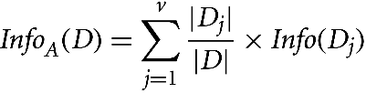
Decision Trees
Expected amount of information needed to classify a tuple in D based on the partitioning by feature A.

Slide 61
Decision Trees
Expected amount of information needed to classify a tuple in D based on the partitioning by feature A.
Sum over all branches of feature A. For example, the feature Age has three branches, youth, middle_aged, and senior

Slide 62
Decision Trees
Out of all tuples in the dataset, count how many tuples fall into the j^{th} branch
Expected amount of information needed to classify a tuple in D based on the partitioning by feature A.
Sum over all branches of feature A. For example, the feature Age has three branches, youth, middle_aged, and senior

Slide 63
Decision Trees
Out of all tuples in the dataset, count how many tuples fall into the j^{th} branch
Expected amount of information needed to classify a tuple in D based on the partitioning by feature A.
The purity of the j^{th} branch
Sum over all branches of feature A. For example, the feature Age has three branches, youth, middle_aged, and senior

Slide 64
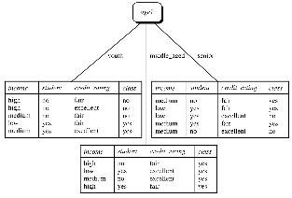



Decision Trees

Slide 65
Decision Trees
j goes from 1 to 3 to cover youth, middle_aged, and senior branches. This first term is for youth. Out of 14 tuples in the entire dataset, 5 belong to youth. Among those 5 tuples, we have 2 ‘yes’ and 3 ‘no’ under youth.

Slide 66
Decision Trees
This first term is for middle_age. There are 4 ‘yes’ only.

Slide 67
Decision Trees
3 ‘yes’ and 2 ‘no’ for seniors.

Slide 68
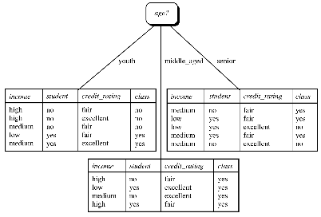
Decision Trees
Step 2 (cont’d):
Gain (Age) = Info(D) - Info_{Age}(D)
= 0.940 - 0.694 = 0.246
Gain (income) = 0.029
Gain (student) = 0.151
Gain (credit_rating) = 0.048
Decision: Split along ‘Age’ first since it leads to the purest outcomes!

Slide 69

Decision Trees
The expected information needed to classify a tuple in dataset D is given by

Slide 70


Decision Trees
The expected information needed to classify a tuple in dataset D is given by
The expected information needed to classify a tuple by splitting along attribute A is

Slide 71

Decision Trees
The expected information needed to classify a tuple in dataset D is given by
The expected information needed to classify a tuple by splitting along attribute A is
The expected information gain by splitting along attribute A is
Calculate Gain(A) for all attributes, pick the attribute with the most information gain. Continue recursively.

Slide 72
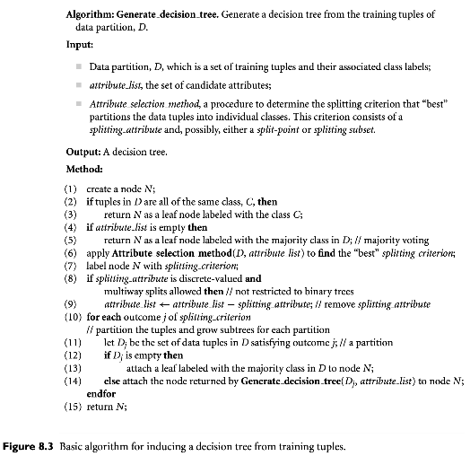
Strategy: Recursively build the tree. Start with a dataset and list of ‘unused’ attributes. At each step, use the best attribute to split the dataset. Along each split/branch, recursively do the same thing.

Slide 73
We will recursively add nodes to the decision tree

Slide 74
Exit conditions in recursive implementation. We exit code if the branch is completely pure, or if we’re used up all the features.

Slide 75
Find the best splitting feature. You can use Information Gain or other suitable algorithms

Slide 76
Perhaps ‘age’ is the best attribute. Label node N as ‘age’

Slide 77
So we’ve used up ‘age’. In next recursive visits to each branches of age, we do not want to use ‘age’ as a potential splitting feature

Slide 78
For each branch of ‘age’, recursively do the same thing.

Slide 79
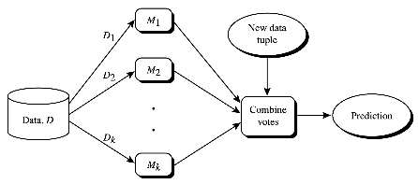
Ensemble Methods
Multiple models are trained on subsets of the original dataset. Given a new test datapoint, the models ‘vote’ their classification results. Majority votes determine the final prediction.

Slide 80
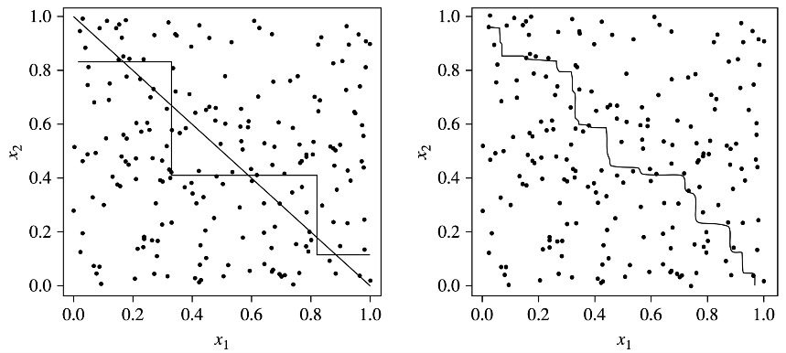
An ensemble tends to be more accurate than its base classifiers. In the figure, the ground truth is a linear separation boundary between two classes we want to classify. A decision tree model (left) struggles to draw a line. An ensemble of decision tree models (right) does a much better job.

Slide 81
Ensemble Methods
Three major variations:
Bagging
Random Forests
Boosting

Slide 82

Bootstrap Aggregation: Bagging
We have d data points in our full dataset, D

Slide 83
Bootstrap Aggregation: Bagging
Randomly sample d data points with replacement out of D. The same datapoint can appear multiple times, while some data points can get left out. Each of the k models sees a slightly different training dataset.

Slide 84
Bootstrap Aggregation: Bagging
Train the models using any algorithm (decision tree, logistic regression, SVM, etc.)

Slide 85
Bootstrap Aggregation: Bagging
Vote to determine the prediction. Equal weight of individual votes.

Slide 86
Bootstrap Aggregation: Bagging
Significantly improves accuracy over a single model fitted on the entire dataset
Robust to noise and overfitting

Slide 87
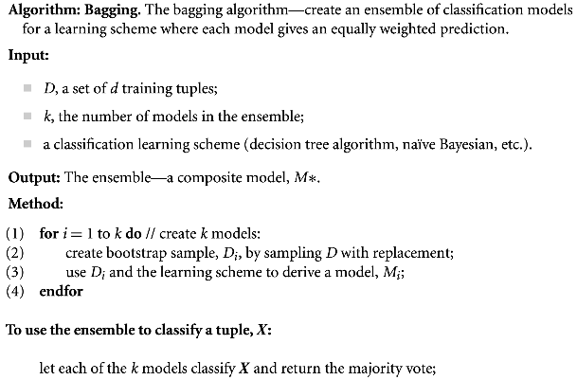
Bootstrap Aggregation: Bagging

Slide 88
Random Forest
We have d data points in our full dataset, D

Slide 89
Random Forest
Once again, randomly sample d data points with replacement out of D to train each model

Slide 90
Random Forest
Now the classifiers must use the Decision Tree algorithm. Each node in the decision tree can use only a small number of features (randomly selected out of all available features) to determine the splitting feature. The process is repeated for each of the k models.

Slide 91
Random Forest
Vote to determine the prediction. Equal weight of individual votes.

Slide 92
Random Forest
Significantly improves accuracy over a single model fitted on the entire dataset
The more uncorrelated individual models are, the better!
Larger number of trees is better
Robust to noise and overfitting

Slide 93
References
Data Mining: Concepts and Techniques, 3rd edition, by Jiawei Han, Michelin Kamber, and Jian Pei

Slide 94
Summary

